Slide 1
HDFC BANK
EǪUITY RESEARCH
Financial Analysis,Forecast C Valuation
Analysis Period: FY2022–FY2026
Independent Equity Research Project
by Varshitha Chowdary

Slide 2
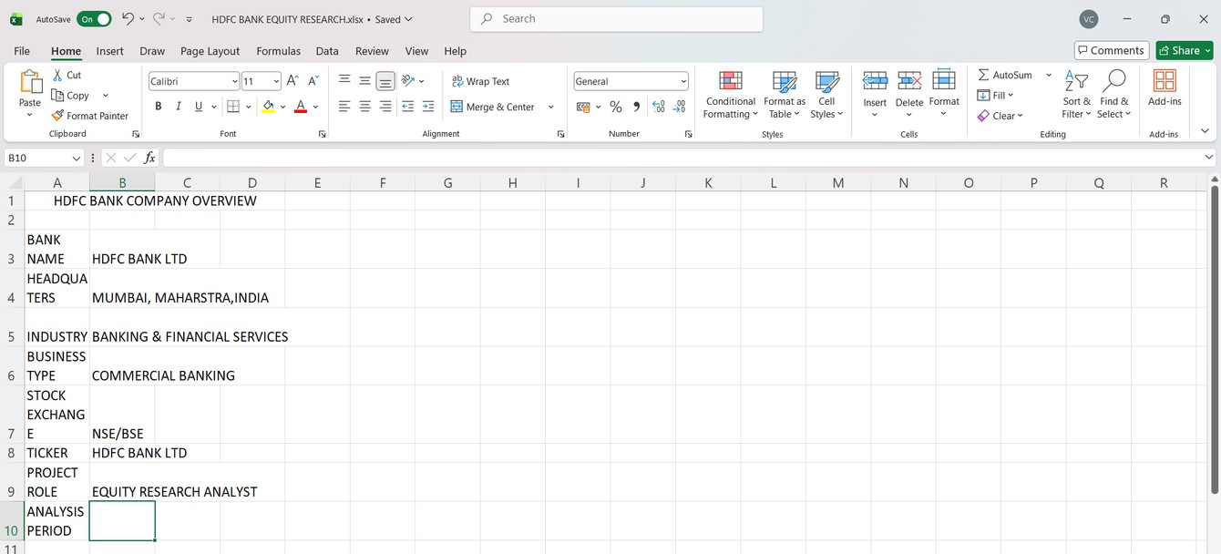
HDFC Bank — Company Overview
Company Snapshot Bank: HDFC Bank
Industry: Banking C Financial Services Business: Private-Sector Commercial Banking
Core Segments: Retail Banking, Wholesale Banking C Treasury Analysis Period: FY2022–FY2026 Research Focus
Financial Performance | Risk | Forecasting
| Valuation
Objective: Evaluate HDFC Bank's financial performance, future growth potential and investment attractiveness using an independent equity-research framework.

Slide 3
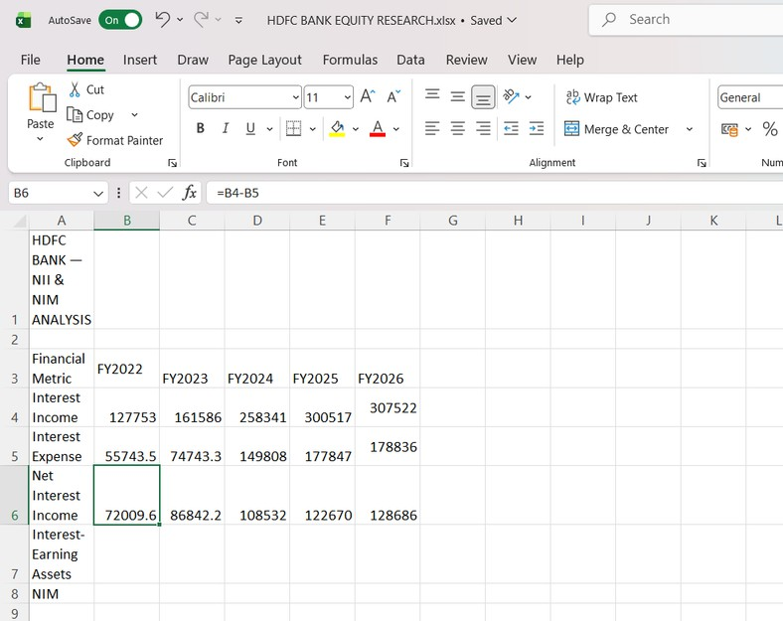
FIVE-YEAR FINANCIAL PERFORMANCE
Net Interest Income (NII)
Year FY2022 FY2023 FY2024 FY2025 FY2026
NII
₹72,010 Cr
₹86,842 Cr
₹1,08,532.5 Cr
₹1,22,670 Cr
₹1,28,686 Cr
Analyst Interpretation
The sustained increase in NII reflects growth in the bank's interest-earning asset base, supported by expansion in loans and deposits.
Key Finding
NII increased significantly from ₹72,010 Cr in FY2022 to
₹1,28,686 Cr in FY2026, indicating strong expansion in core banking earnings.

Slide 4
KEY FINANCIAL METRICS FY2026
GROWTH
NII CAGR — 16%
NII Growth — 5% Loan Growth — 11%
Deposit Growth — 14%
PROFITABILITY NIM — 3.50%
ROA — 1.90%
ROE — 14.80%
RISK C CAPITAL GNPA — 1.25%
Key Takeaway: HDFC Bank demonstrates healthy balance-sheet growth, strong profitability and controlled asset quality.

Slide 5
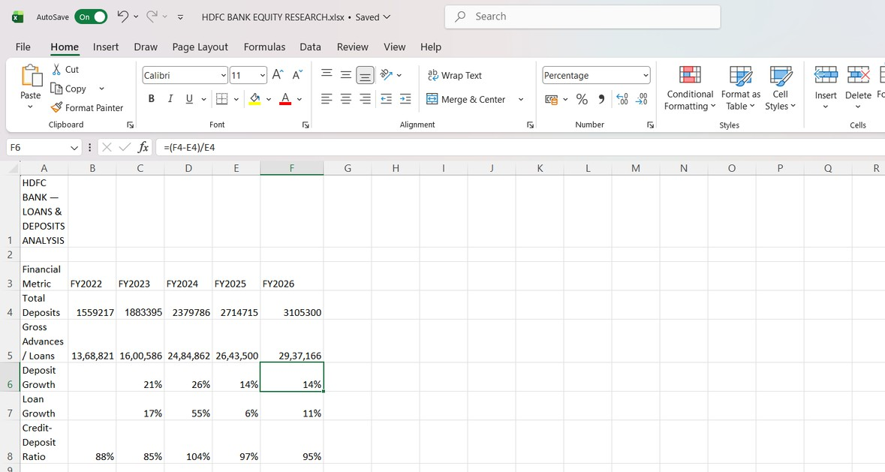
LOANS G DEPOSITS - FIVE YEAR TREND
FY2026
Loans: ₹29,37,166 Cr Deposits: ₹31,05,300 Cr Loan Growth: 11%
Deposit Growth: 14%
Key Takeaway: Deposits continue to grow faster than loans, supporting a healthy funding position and balance-sheet expansion.

Slide 6
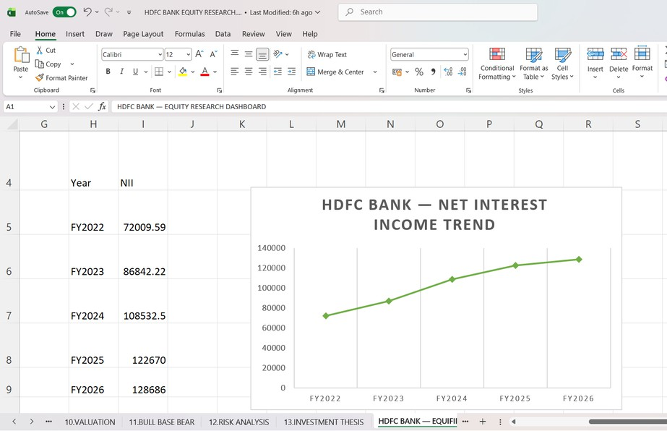
NET INTEREST INCOME G PROFITABILITY
NII Performance FY2022 NII: ₹72,010 Cr
FY2026 NII: ₹1,28,686 Cr NII CAGR: 16%
FY2026 NII Growth: 5%
Profitability NIM: 3.50%
ROA: 1.90%
ROE: 14.80%
Key Takeaway: NII has expanded strongly over the five-year period, while profitability remains supported by healthy margins and returns.

Slide 7
ASSET ǪUALITY G RISK
Key Risk Metrics
GNPA 1.25%
Risk Interpretation
1. Controlled asset quality with GNPA at 1.25%.
2. 95% credit–deposit ratio indicates strong deployment of deposits into loans.
3. 11% loan growth reflects continued expansion while maintaining risk discipline.
Credit–Deposit Ratio 95%
Capital Adequacy Strong
Key Takeaway: HDFC Bank maintains controlled asset-quality risk while continuing to expand its lending portfolio.
Loan Growth 11%

Slide 8
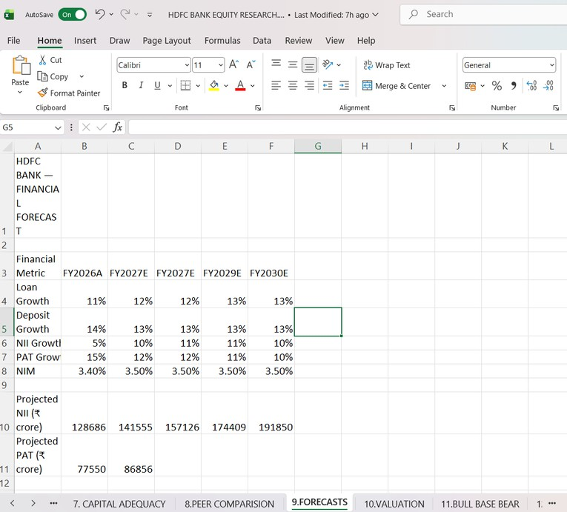
FORWARD OUTLOOK G FORECAST
Forecast Assumptions
FY2027E
Loan Growth: 12%
Deposit Growth: 13%
NII Growth: 10%
PAT Growth: 12%
NIM: 3.50%
Analyst View
Growth Outlook
Continued balance-sheet expansion is expected, supported by loan and deposit growth.
Earnings Outlook
NII and PAT are projected to grow at a moderate pace, while NIM is assumed to remain broadly stable.
Model Approach
Forecasts are based on analyst assumptions and are not company guidance.
Key Takeaway: The base forecast assumes sustainable growth with stable margins rather than aggressive long-term expansion.

Slide 9
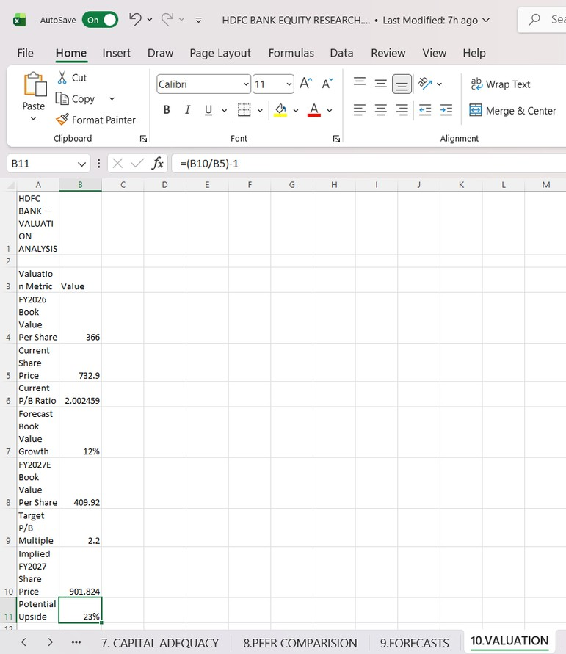
P/B VALUATION
Valuation Metrics
Reference Price
₹732.90
Current P/B 2.00× FY2027E BVPS
₹409.92
Target P/B 2.20×
Target Price
₹901.82
Potential Upside 23.0%
Key Takeaway: The base-case P/B valuation indicates approximately 23% potential upside, while the scenario analysis highlights the range of possible valuation outcomes.
Valuation is based on the assumptions and P/B framework used in this analysis.

Slide 10
FINAL INVESTMENT VIEW
🟢 BUY
BASE TARGET PRICE: ₹901.82 POTENTIAL UPSIDE: 23.0%
BEAR → ₹711.50
BASE → ₹901.82
BULL → ₹1,052.25
Investment thesis: HDFC Bank combines scale, strong capitalization and a resilient deposit franchise with improving earnings potential.
BUY : subject to the assumptions and valuation framework used in this analysis.

